Slide 1
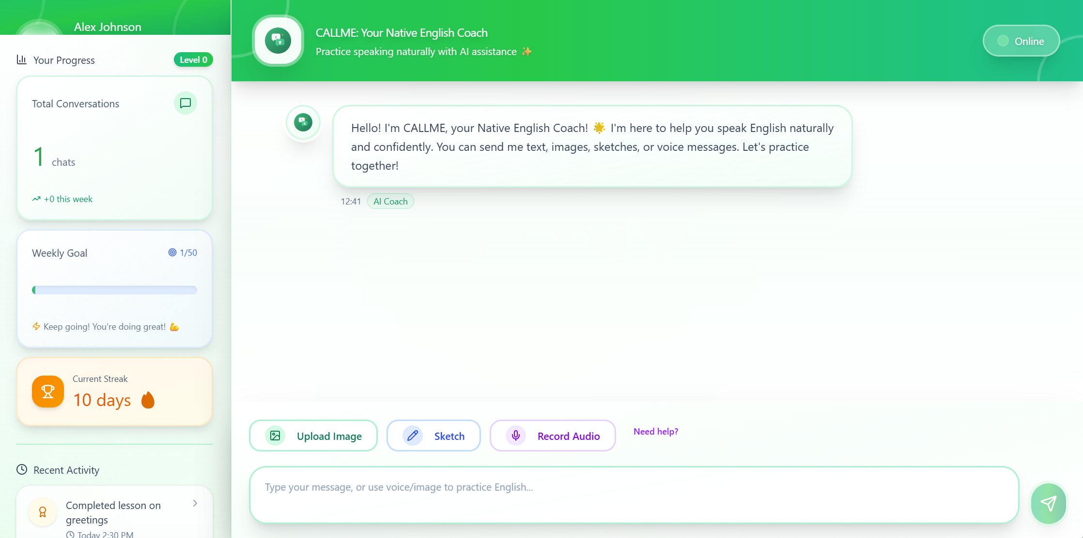
Frontend: Figma

Slide 2
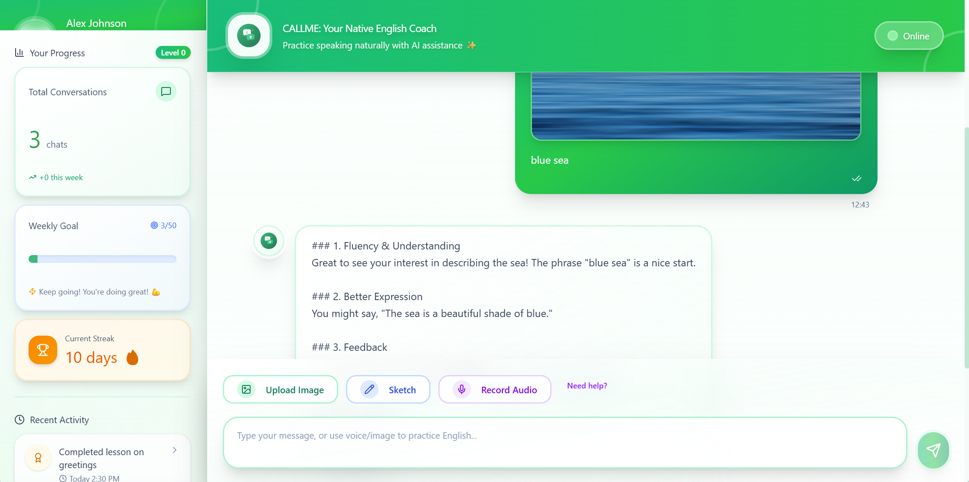
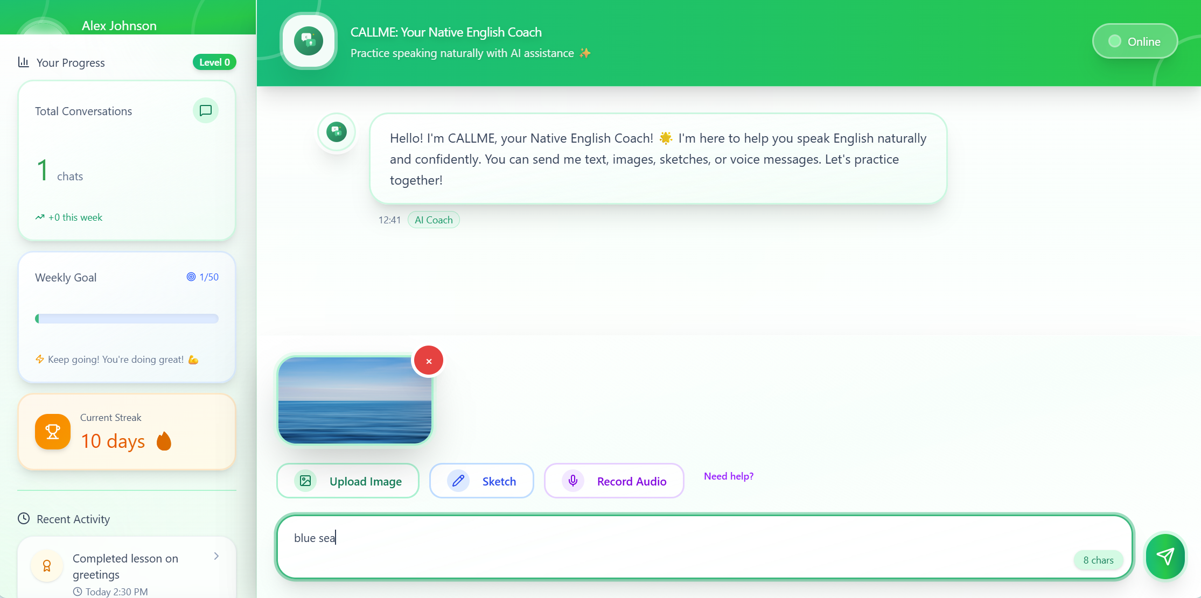
Frontend: Figma (Conversation)

Slide 3
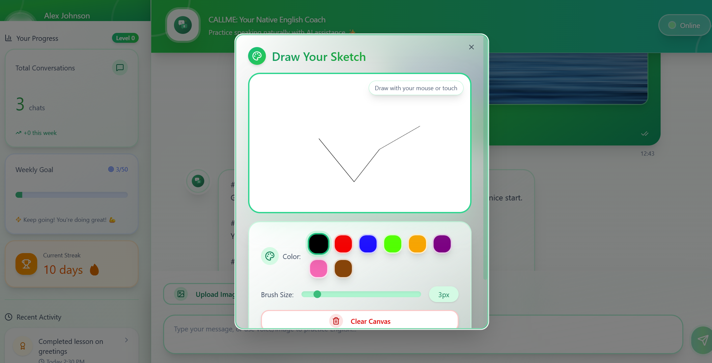
Frontend: Figma (Sketch)

Slide 4
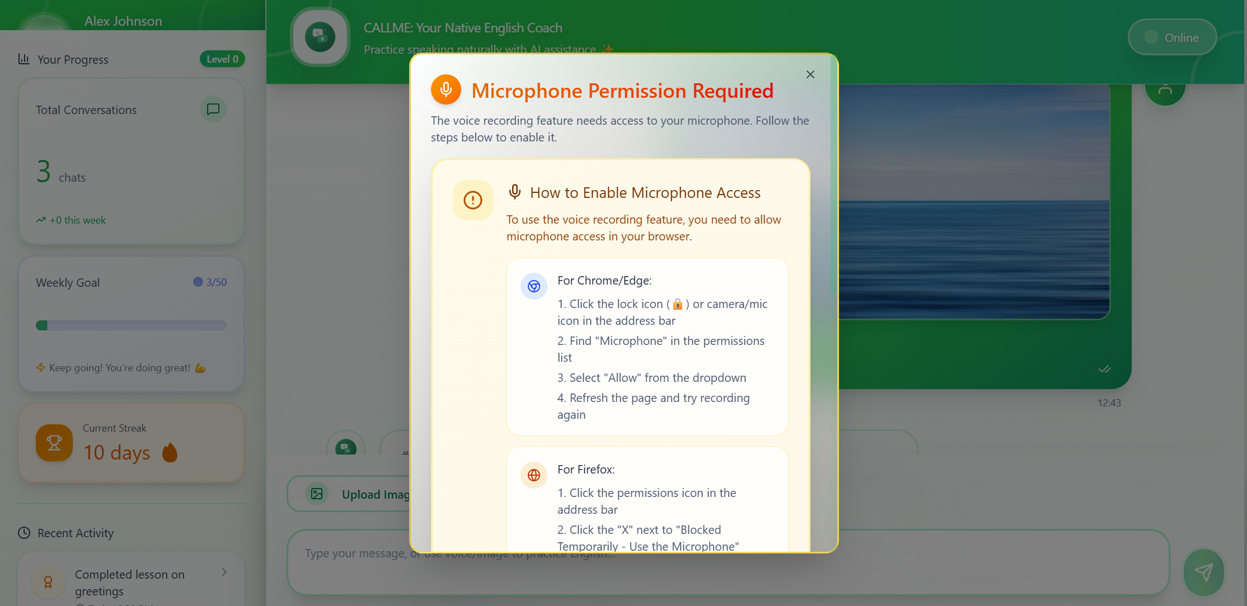
Frontend: Figma (Audio)

Slide 5
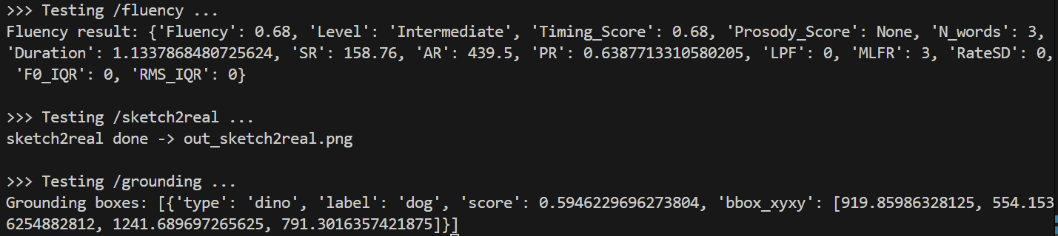
Backend: GPU * 1 (local)
Local: uvicorn api:app --host 0.0.0.0 --port 7777
Forward to the public domain: ./cloudflared tunnel --url localhost:7777

Slide 6
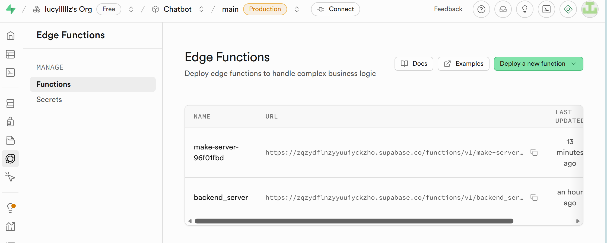
Backend: Spuabase (Edge Function -- Post & Response)

Slide 7
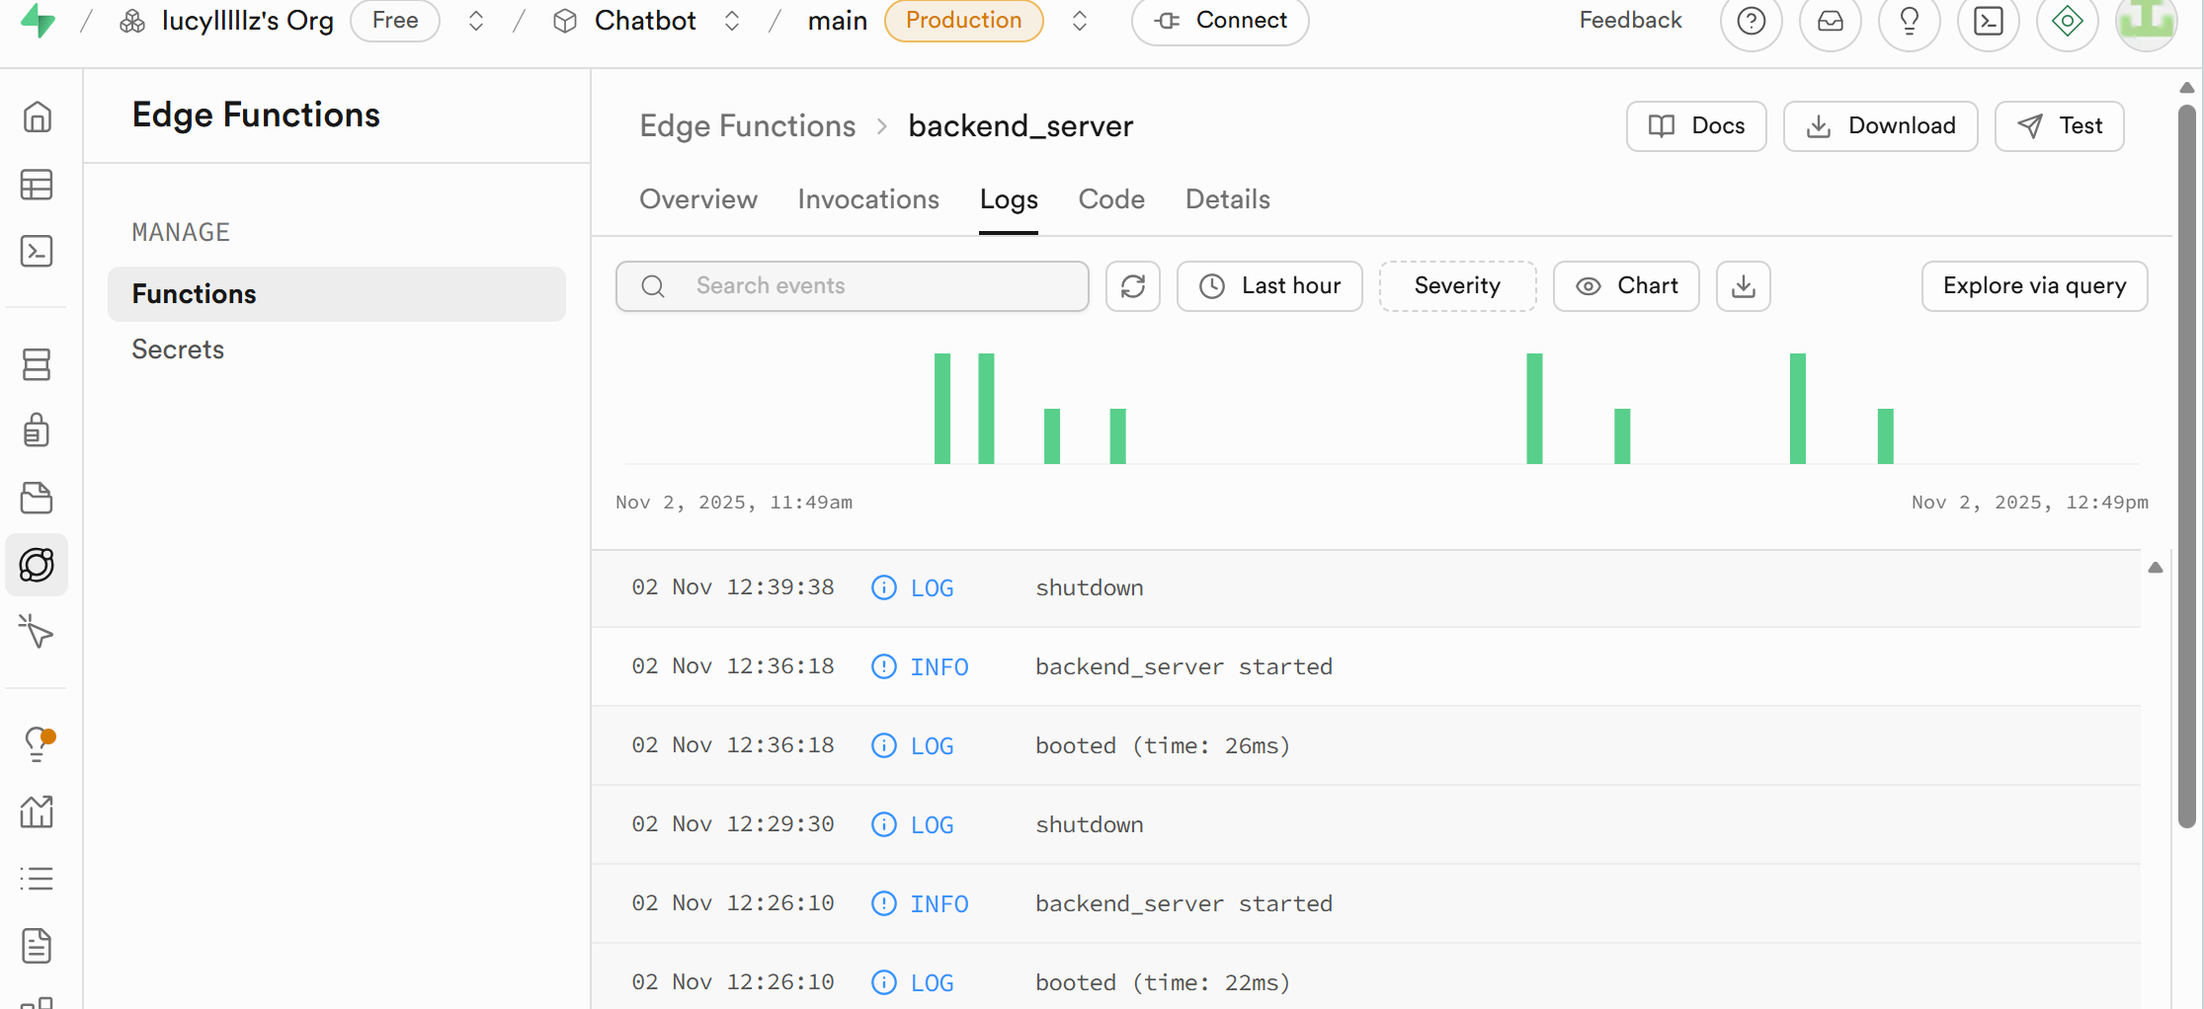
Backend: Spuabase (Edge Function -- Post & Response)

Slide 8
Human Evaluation?
Subjective
Need 20 samples: user audio + image + user transcript (dataset selection)
Input these data into CALLME and generate Response (response collection) -- Me
Using 2 LLMs to evaluate generated responses (based on user’s transcript) (LLM evaluation) -- Me

Slide 9
PPT framewor & Pre Draft?
Han Jing first complete a PPT version 1:
Why callme(previous+problem statement), so callme is constructed... 1min
→Video show our functions -- What this app does 1min
→The technology inside --
-- pipeline 1min (target--try to solve what problem)
-- Grounding 1min
-- Audio (※) 2min
-- Sketch to Image 1min
→Dataset construction(analysis) 1min
→ Evaluation -- LLM evaluation 1min
→ Conclusion + future work 1min

